Slide 1
Conditional Random Fields
CRF

Slide 2
Introduction to CRF
Imagine you have a sequence of snapshots from a day in Justin Bieber’s life, and you want to label each image with the activity it represents (eating, sleeping, driving, etc.). How can you do this?
One way is to ignore the sequential nature of the snapshots, and build a per-image classifier. For example, given a month’s worth of labeled snapshots, you might learn that dark images taken at 6am tend to be about sleeping, images with lots of bright colors tend to be about dancing, images of cars are about driving, and so on.
By ignoring this sequential aspect, however, you lose a lot of information. For example, what happens if you see a close-up picture of a mouth – is it about singing or eating? If you know that the previous image is a picture of Justin Bieber eating or cooking, then it’s more likely this picture is about eating; if, however, the previous image contains Justin Bieber singing or dancing, then this one probably shows him singing as well.
Thus, to increase the accuracy of our labeler, we should incorporate the labels of nearby photos, and this is precisely what a conditional random field does

Slide 3
Machine Learning models have two common categorizations, Generative and Discriminative. Conditional Random Fields are a type of Discriminative classifier, and as such, they model the decision boundary between the different classes.
Generative models, on the other hand, model how the data was generated, which after having learnt, can be used to make classifications.
As a simple example, Naive Bayes, a very simple and popular probabilistic classifier, is a Generative algorithm, and Logistic Regression, which is a classifier based on Maximum Liklihood estimation, is a discriminative model.

Slide 4
Conditional Random Fields
Conditional Random Fields are a discriminative model. Conditional Random Fields are a type of Discriminative classifier, and as such, they model the decision boundary between the different classes.
It is used for predicting sequences.
They use contextual information from previous labels, thus increasing the amount of information the model has to make a good prediction.

Slide 5
Mathematical overview of Conditional Random Fields
Having discussed the above definitions, we will now go over Conditional Random Fields, and how they can be used to learn sequential data.
We model the Conditional Distribution as follows:

Slide 6
Part-of-Speech Tagging
In POS tagging, the goal is to label a sentence (a sequence of words or tokens) with tags like ADJECTIVE, NOUN, PREPOSITION, VERB, ADVERB, ARTICLE.
For example, given the sentence “Bob drank coffee at Starbucks”, the labeling might be “Bob (NOUN) drank (VERB) coffee (NOUN) at (PREPOSITION) Starbucks (NOUN)”.
So let’s build a conditional random field to label sentences with their parts of speech. Just like any classifier, we’ll first need to decide on a set of feature functions.

Slide 7
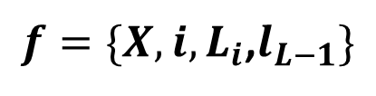
Feature Functions in a CRF
In a CRF, each feature function is a function that takes in as input:
a sentence s
the position i of a word in the sentence
the label li of the current word
the label li−1 of the previous word
and outputs a real-valued number (though the numbers are often just either 0 or 1).
For example, one possible feature function could measure how much we suspect that the current word should be labeled as an adjective given that the previous word is “very”.
To build a conditional random field, you just define a bunch of feature functions (which can depend on the entire sentence, a current position, and nearby labels), assign them weights, and add them all together, transforming at the end to a probability if necessary.
${f=\{X, i,L}_{i}$,$l_{L−1}\}$

Slide 8
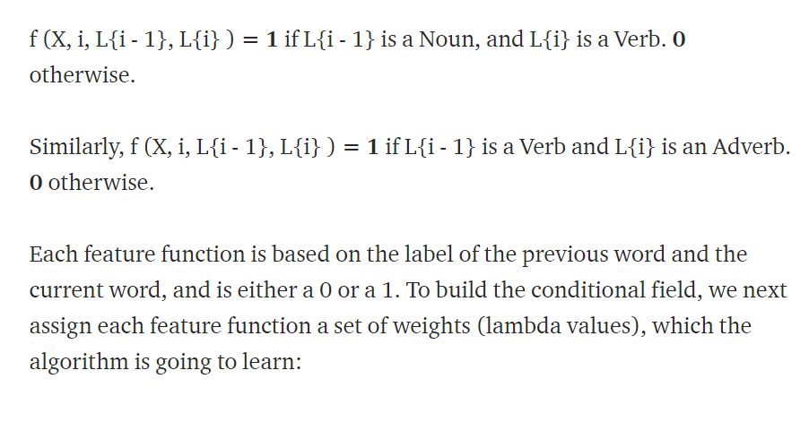
Feature Functions
The dog ate my food
Ben worked carefully

Slide 9

Steps for Conditional Random Field
First determine the feature functions
Next, assign each feature function a weight. Given a sentence s, we can now score a labeling l of s by adding up the weighted features over all words in the sentence:
(The first sum runs over each feature function j, and the inner sum runs over each position i of the sentence.)
Finally, we can transform these scores into probabilities p(l|s) between 0 and 1 by exponentiating and normalizing
sentence

Slide 10
Applications of CRFs
Given their ability to model sequential data, CRFs are often used in Natural Language Processing
Parts-of-Speech tagging. Parts of speech of a sentence rely on previous words, and by using feature functions that take advantage of this, we can use CRFs to learn how to distinguish which words of a sentence correspond to which POS.
Another similar application is Named Entity recognition, or extracting Proper nouns from sentences.
Other applications include parts-recognition in Images and gene prediction.
Pattern recognisition

Slide 11
Difference between conditional random and Hidden Markov Models
Both are used to model sequential data, but they are different algorithms.
Hidden Markov Models are generative, and give output by modeling the joint probability distribution. On the other hand, Conditional Random Fields are discriminative, and model the conditional probability distribution. CRFs don’t rely on the independence assumption (that the labels are independent of each other), and avoid label bias. One way to look at it is that Hidden Markov Models are a very specific case of Conditional Random Fields, with constant transition probabilities used instead. HMMs are based on Naive Bayes, which we say can be derived from Logistic Regression, from which CRFs are derived.

Slide 12
References
https://www.youtube.com/watch?v=rI3DQS0P2fk&t=1082s
Overview of Conditional Random Fields | by Ravish Chawla | ML 2 Vec | Medium
A Tour of Conditional Random Field – Towards AI — The World’s Leading AI and Technology Publication

